Slide 1

Midterm project Predicting flight delays
Jaden lipp & James ding

Slide 2


Why predict flight delays?
Performance
Operation
Airline & Airport Operations
On time Performance
Cost
Fuel Cost
Flight Vouchers

Slide 3

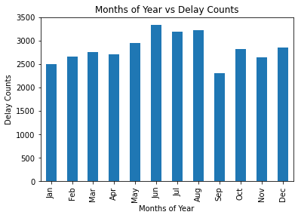
Summer -> Delays
June: 3334 delays
September: 2309 delays
Average: 2829 delays per month

Slide 4

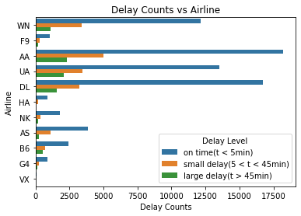
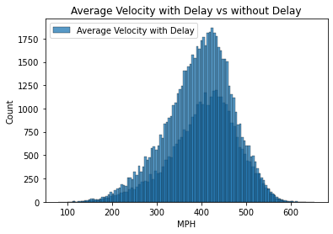
Airlines Analysis

Slide 5
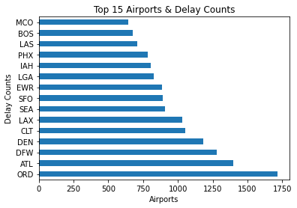
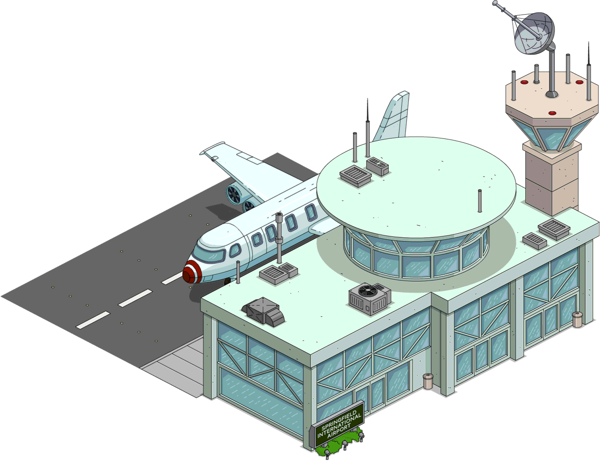
Airports Analysis

Slide 6
Feature Engineering
Take a random sample of 100,000 flights
Evaluate data, identify relationships
Got rid of columns with > 80% missing values
General idea was to average delay times with regards to airline, origin/destination, tail
Leave in other relevant information such as distance and time of day

Slide 7
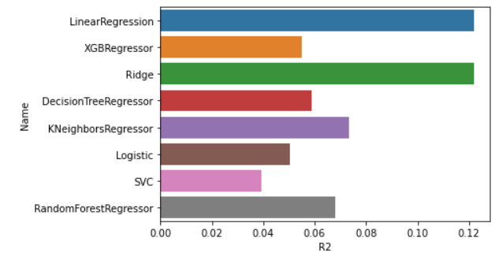
Model Selections
*GaussianNB had a negative R2

Slide 8
Challenges & Reflection
Weather API did not allow access until too late in the process
Figuring out how to best clean the data and pick which features to feature
Navigating the database and retrieving data
Creating arrival delays based on tail number proved tedious, too many tails!

Slide 9

Thank you for listening!

